Slide 2
WHO IS MINT?
WHO IS MINT?
MINT is a SaaS company granting
brands and agencies
governance,
transparency, and efficiency
when managing all their advertising resources, building an “Advertising Equity”

Slide 3
WHO IS MINT?
250
EMPLOYEES
70%
RULE OF 40
(2022)
+34%
GROWTH RATE YOY
(2022 VS 2021)
BERLIN
60%
TECH TEAM
40%
OPERATIONS
LONDON
MILAN
USA (2023)
D&I AS CORE COMPANY VALUE
ROME
42%
MALE
58%
FEMALE
SÃO PAULO
PARIS
Our Customers
Notes:
Key elements: 240 employees, 38% Year-over-year growth. Investment from TIKEHAU.
Keep it quick.

Slide 4
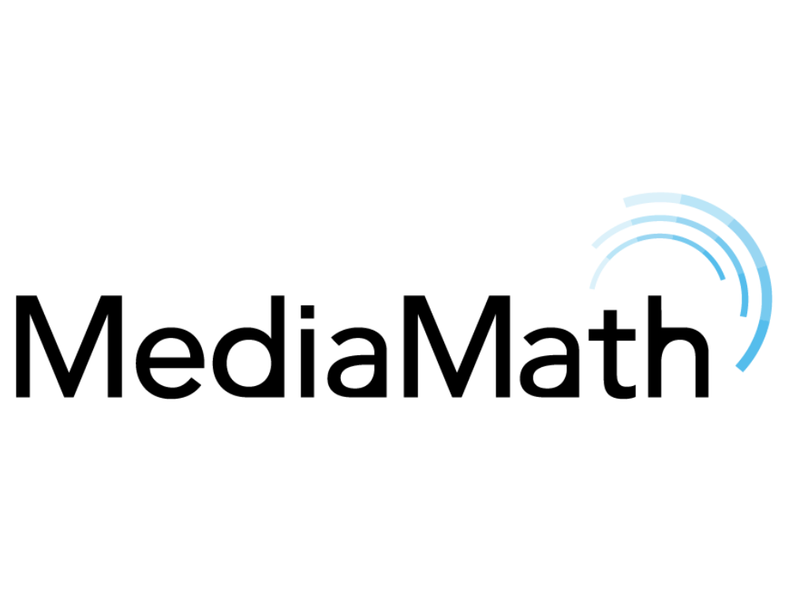
THE SOFTWARE ECOSYSTEM
UNIDENTIFIED
Clients
Prospects
IDENTIFIED
Clients
Prospects
CMO
ARM
CRM
In the broader spectrum of all enterprise management software:
To manage internal resources, you use an ERP.
To manage identified, external contacts, you use a CRM.
CFO
CTO
CFO
To manage and conquer unidentified clients and prospects, you can now use Advertising Resource Management.
ERP
Notes:
What is ARM? It’s making advertisers as important as other teams, making available for them a solution to the age-old problem of “how do I manage my data?”

Slide 5
WHAT IS ARM?
Advertising Resource Management is a category of marketing technology that focuses on helping organizations consolidate their resources, their processes, workflows, and information into a single system to better support their advertising operations.
COMPETITIVE ANALYSIS
MEDIA MIX MODELLING
BRAND SAFETY
OPTIMIZATION
AUDIENCE ANALYTICS
BOOKING MANAGEMENT
AUDIENCE RESEARCH
STRATEGY & PLANNING
SCHEDULING
ACTIVATION
REPORTING
INVOICE & PAYMENT MANAGEMENT
ADMINISTRATION
AUDIENCE PLANNING
CREATIVE AUTOMATION
TRAFFICKING
ATTRIBUTION MODELS
DYNAMIC CONTENT OPTIMIZATION
ACCOUNTING
SYSTEM INTEGRATION
BACKBONE PROCESS
ADJACENT TECHNOLOGIES
Notes:
- Video Prodotto

Slide 6
WHAT WE CREATED
MINT is the backbone of ARM, connecting all advertising resources across internal and external processes, providing a single source of truth and streamlining operations across the enterprise. It’s capable of integrating and connecting every core step of the advertising ecosystem in one platform and breaking down information silos.
COMPETITIVE ANALYSIS
MEDIA MIX MODELLING
BRAND SAFETY
OPTIMIZATION
AUDIENCE ANALYTICS
BOOKING MANAGEMENT
AUDIENCE RESEARCH
STRATEGY & PLANNING
SCHEDULING
ACTIVATION
REPORTING
ADMINISTRATION*
INVOICE & PAYMENT MANAGEMENT
AUDIENCE PLANNING
CREATIVE AUTOMATION
TRAFFICKING
ATTRIBUTION MODELS
DYNAMIC CONTENT OPTIMIZATION
ACCOUNTING
SYSTEM INTEGRATION
COVERED BY MINT
EXTERNAL ADDONS / FUTURE DEVELOPMENTS
* IN ROADMAP
Notes:
- Video Prodotto

Slide 7
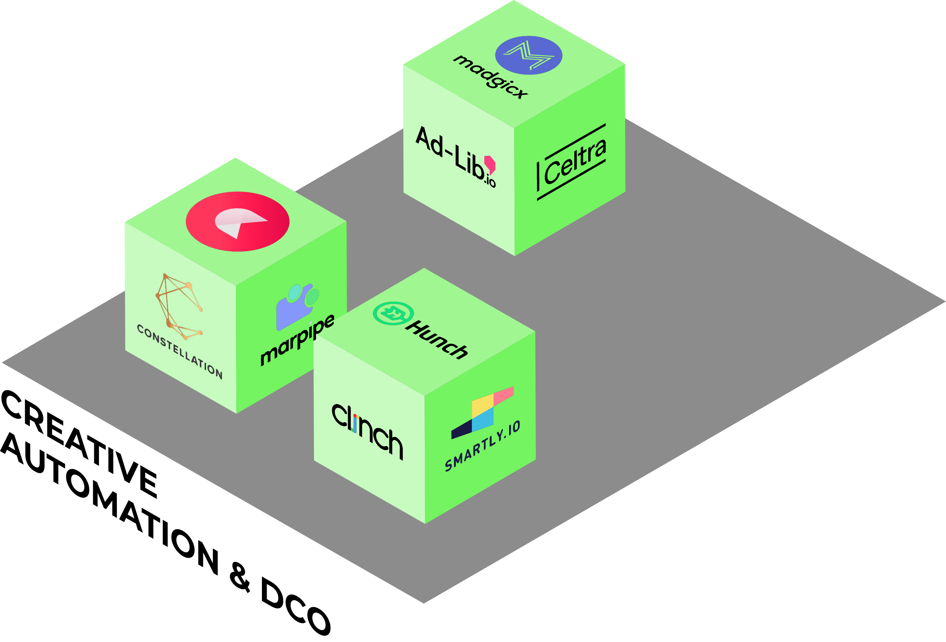
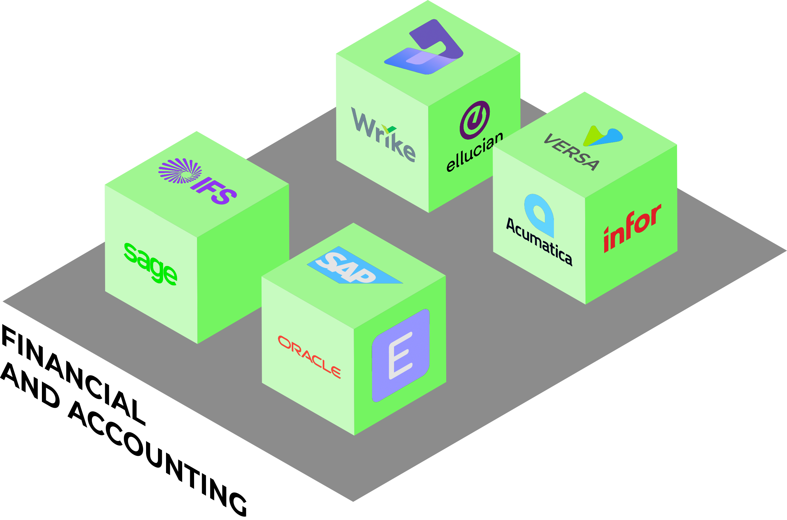
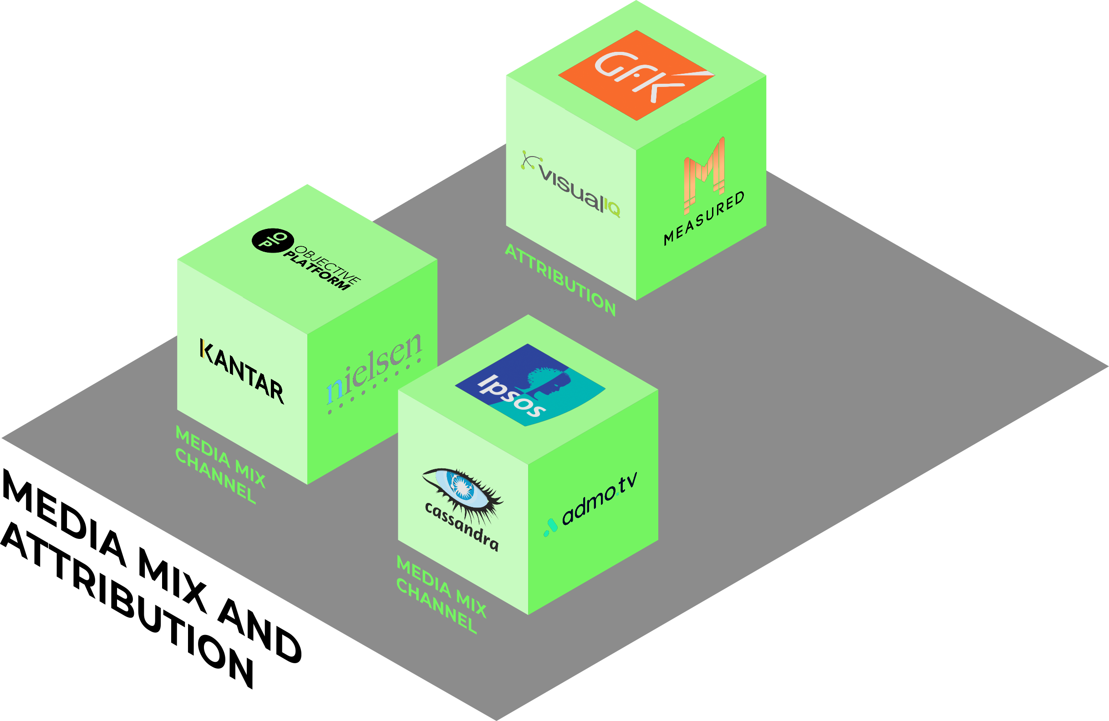
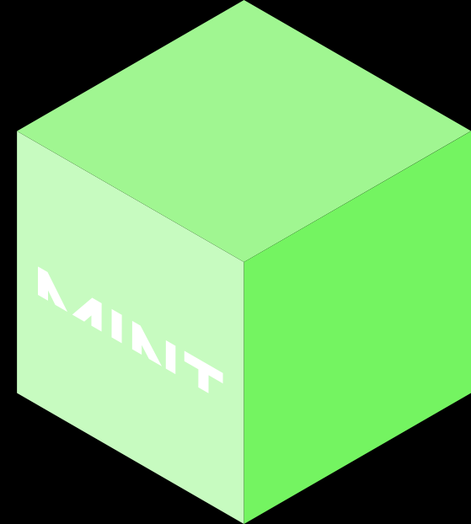
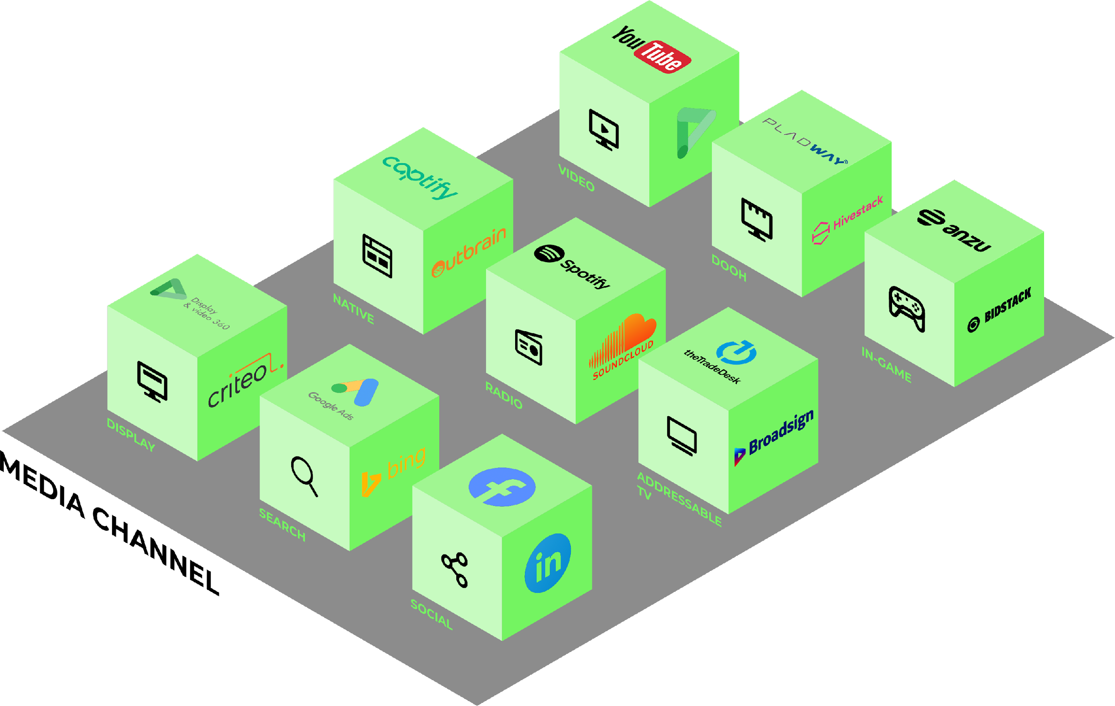
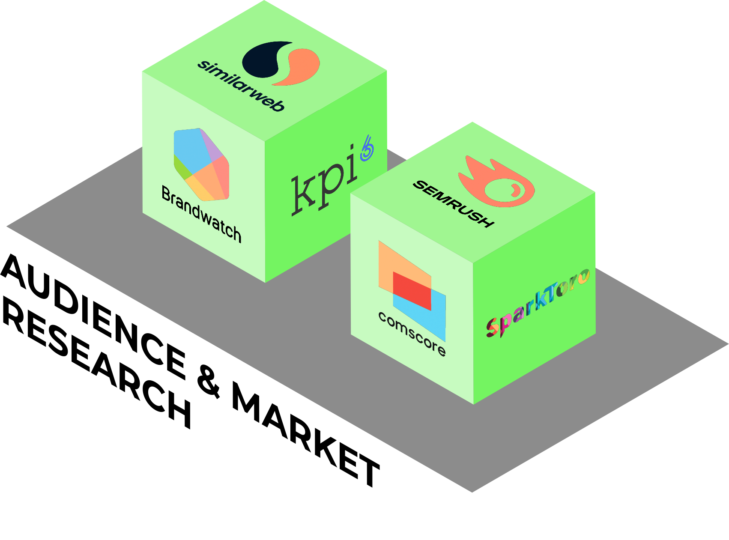
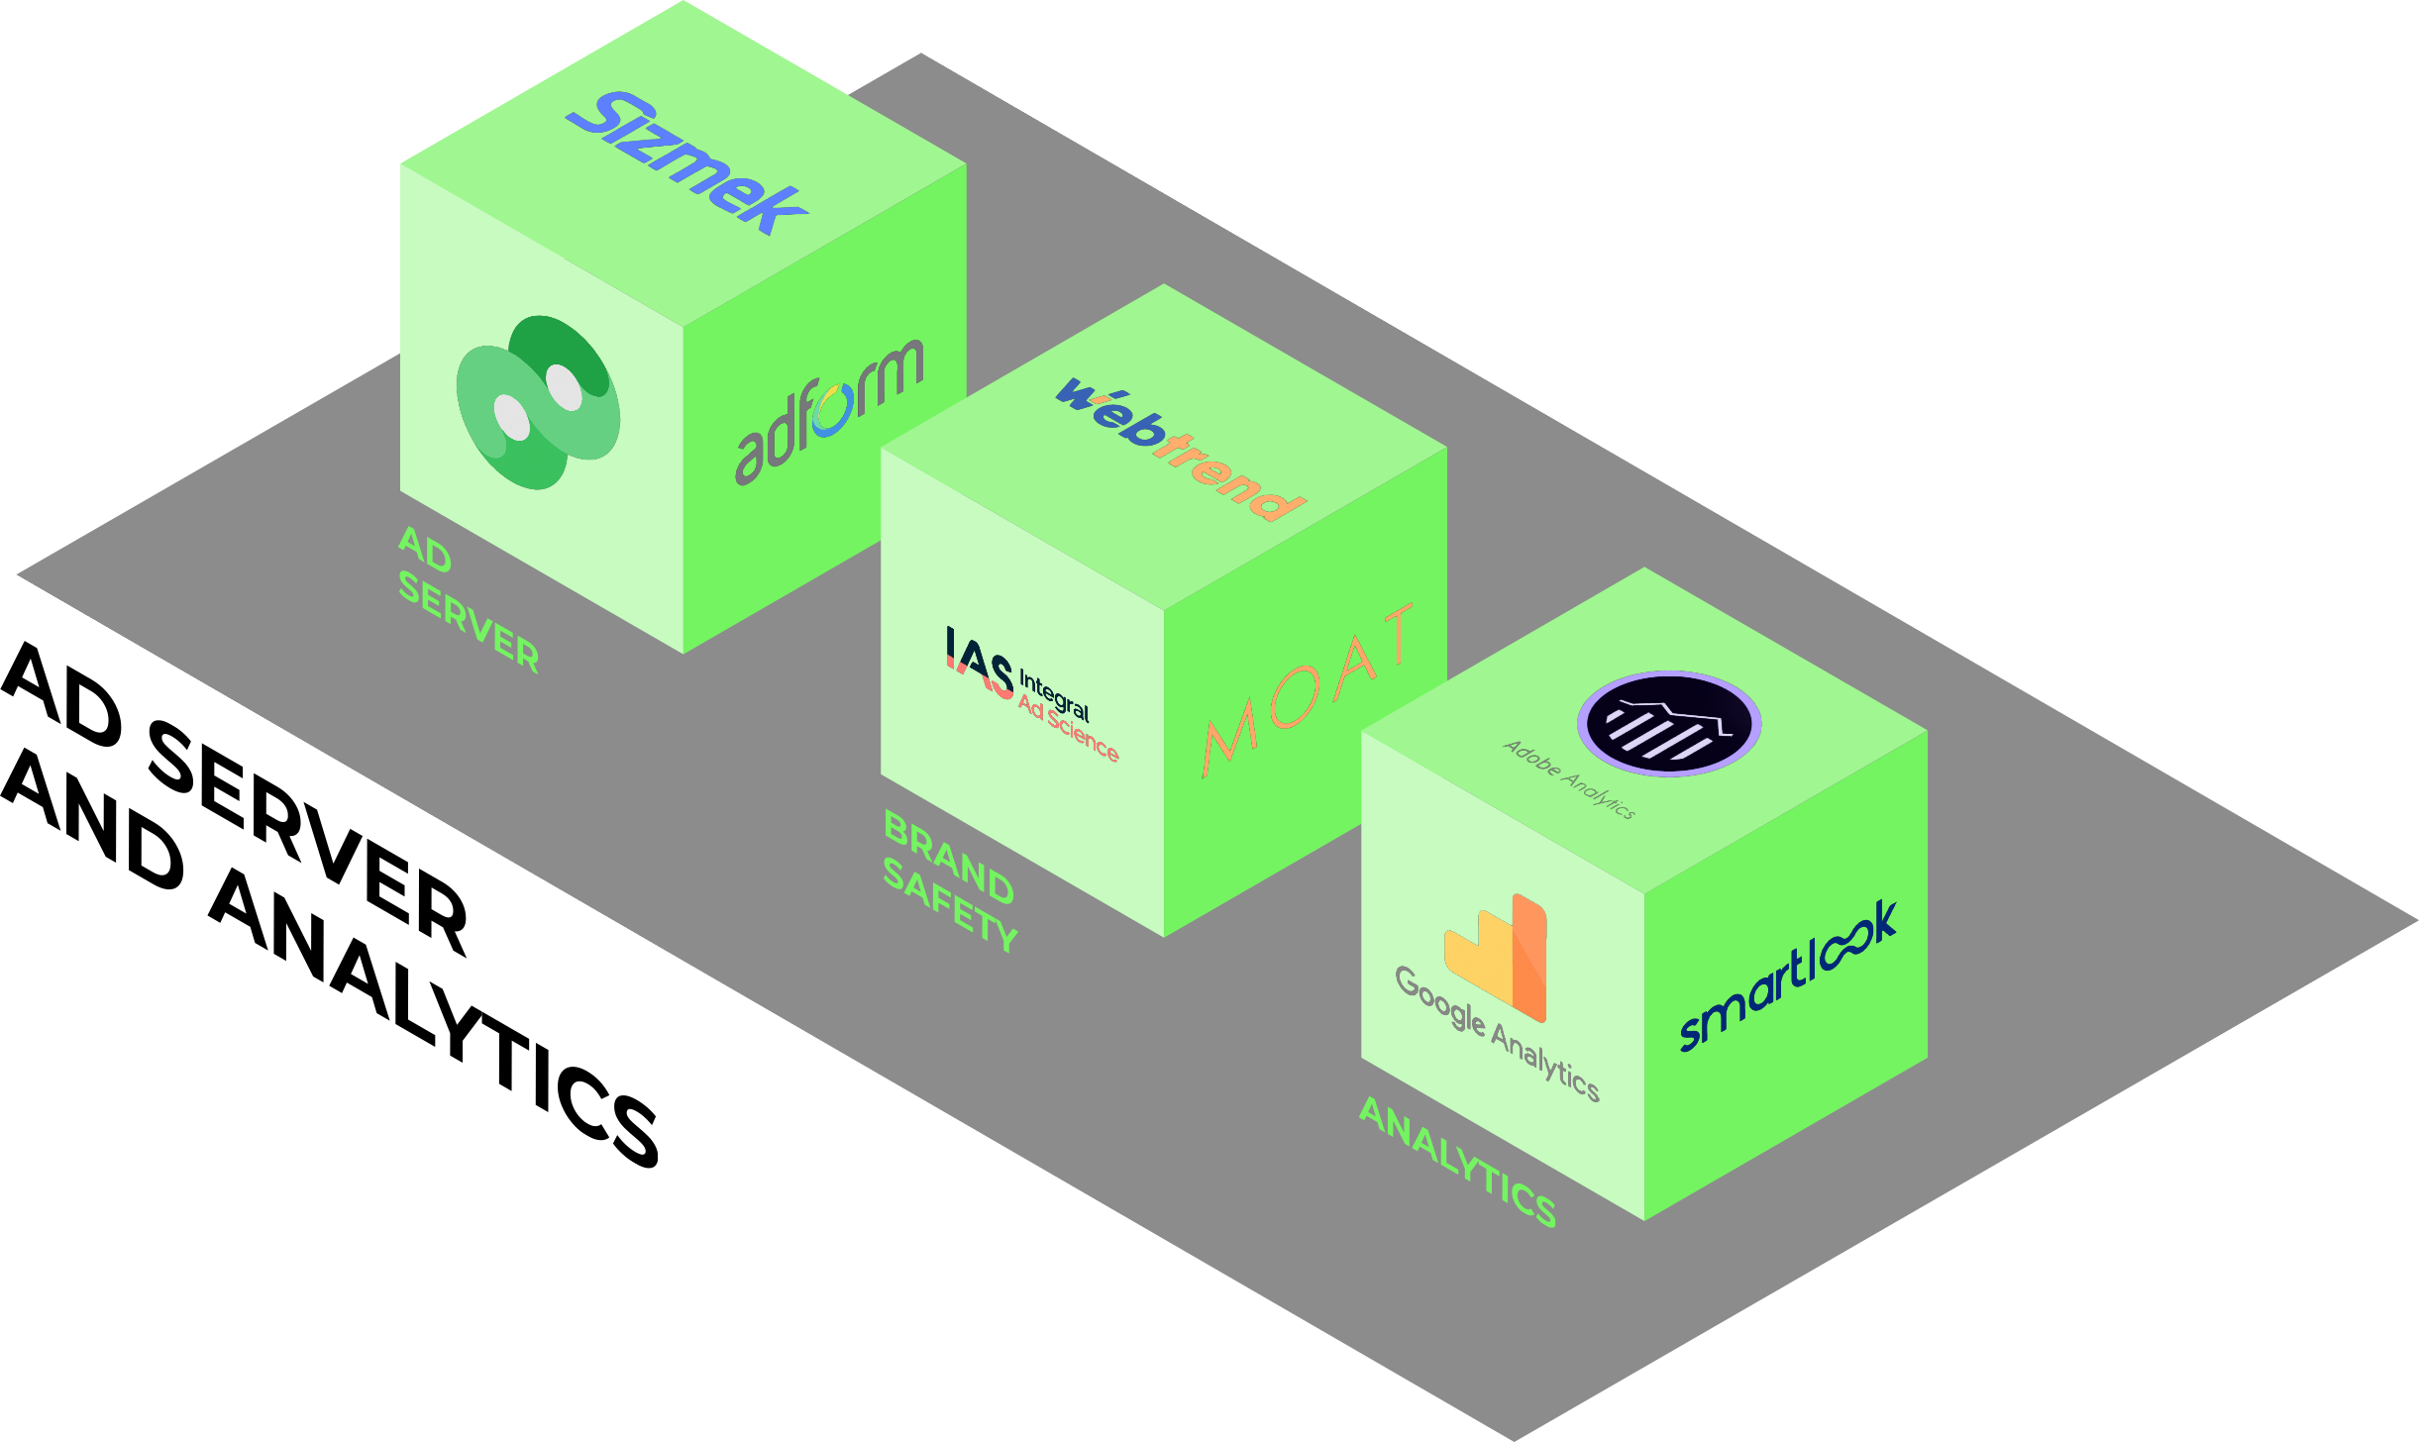
ORCHESTRATING
ALL DIGITAL CHANNELS
350+ INTEGRATIONS
12 CHANNELS
ONE PLATFORM
Notes:
A central platform, connecting with 12 channels and more than 300 integrations, to get you a omnicomprehensive solution across all your advertising

Slide 8
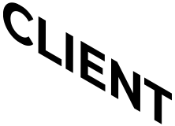
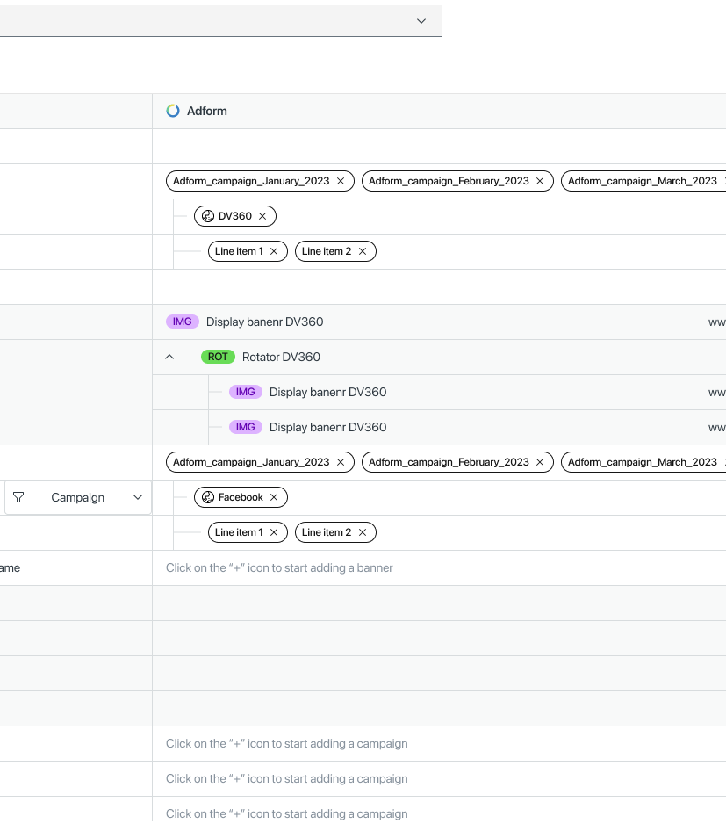
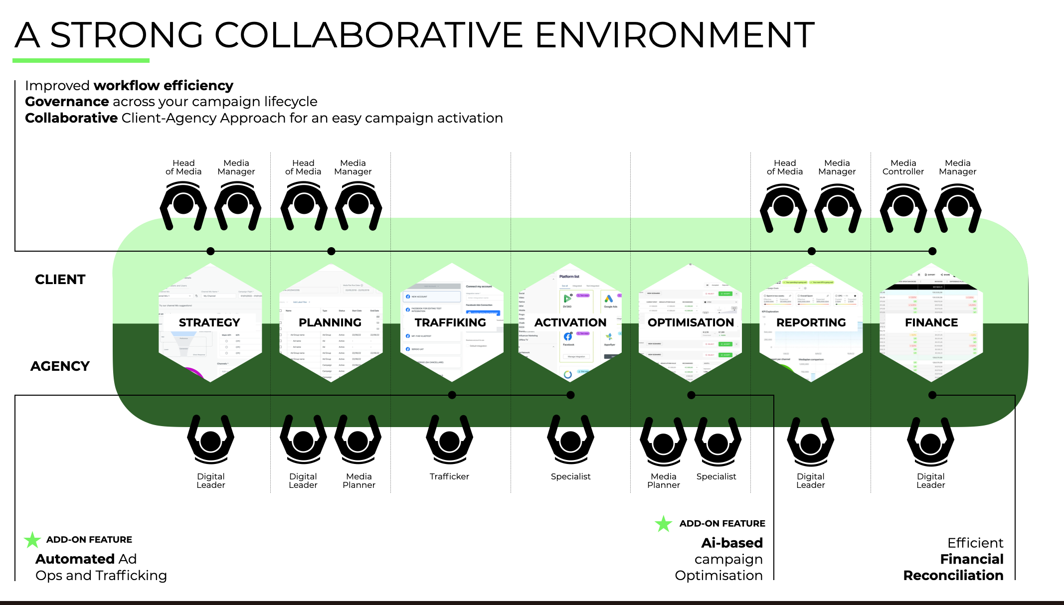
CLIENTS AND AGENCY TOGETHER
CONNECTING CLIENTS AND THEIR AGENCY
VIA A COLLABORATIVE PLATFORM
A STRONG COLLABORATIVE ENVIRONMENT
MINT is the solution to connect two otherwise siloed environments: Client and Media Agency.
By providing an easy-to-use collaborative environment the teams can have improved workflow efficiency, automating mundane tasks and improving governance across the entire campaign lifecycle.
Head
of Media
Media Manager
Head
of Media
Media Manager
Head
of Media
Media Manager
Media Controller
Media Manager
CLIENT
STRATEGY
PLANNING
TRAFFICKING
ACTIVATION
OPTIMIZATION
REPORTING
FINANCE
AGENCY
Digital Leader
Digital Leader
Media Planner
Trafficker
Specialist
Media Planner
Specialist
Digital Leader
Digital Leader
ADD-ON FEATURE
ADD-ON FEATURE
Automated Ad Ops and Trafficking
AI-based
campaign Optimization
Efficient Financial Reconciliation
Notes:
A central platform, connecting with 12 channels and more than 300 integrations, to get you a omnicomprehensive solution across all your advertising

Slide 9
CROSS-MARKET CONSISTENCY
Thanks to MINT, multinational corporations become more competitive by having one single tool for cross market media management, at both a planning and execution level, with more time on optimization strategy and less for mundane tasks.
Major benefits are:
Cost Control
Consistency of message across markets
Reduction in human error
Feedback loop
Perfect pivot for Brand, Markets, Regions, etc.
Future AI-powered feature:
Automatically identify your company's best performing actions across all products and markets, making it easy to share them with the rest of the organization.
HQ View
≠
Global CMO
Regional View
Head of GEO
≠
Market View
Country Manager
Notes:
With everything connected and in one place, you can start building your own data lake, you can start developing your own advertising equity that stays with you even if you decide to change agencies or hire different people

Slide 10
THE DATA ICEBERG
Cookies
Pre-bid data
Universal ID
Graph ID
USER DATA
RISK
OPPORTUNITY
EVENTS DATA
Consider for a moment that all the data we collect is like an iceberg. Audience and user data are just the tip.
With that section now melted away, what lies below? An enormous amount of valuable data!
That is what MINT collects and focuses on. Data made up of non personally identifiable information that is inherently part of your campaigns, but that is rarely looked at.
Clicks
Budget
Engagement
Conversions
Impressions
Pacing
Events
Frequency
Visits
CPA/CPL
Time

Slide 11
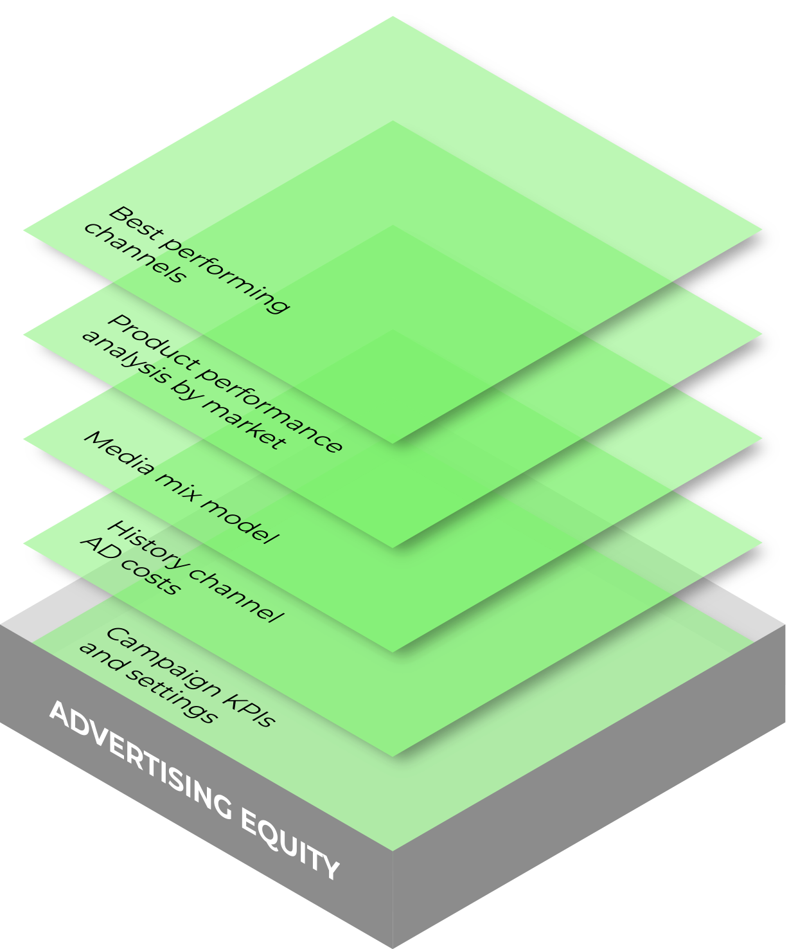
ADVERTISING EQUITY
Advertising big data comes in a variety of shapes and colours. MINT integrates and consolidates data coming from all campaign technologies, models, process, configurations, platforms, and media to give you the best possible channel mix and suggestions based not only on market data, but on your own advertising history too.
Building your own Advertising Equity will empower you to improve your strategy and results whilst getting ready for the cookie-less era.
Channel Performance
Product and Market Performance
Media Mix Modeling
Media Costs
Campaign Settings
Notes:
With everything connected and in one place, you can start building your own data lake, you can start developing your own advertising equity that stays with you even if you decide to change agencies or hire different people

